Slide 1
Latinos and Washington State
Carlos B. Gil

Slide 2
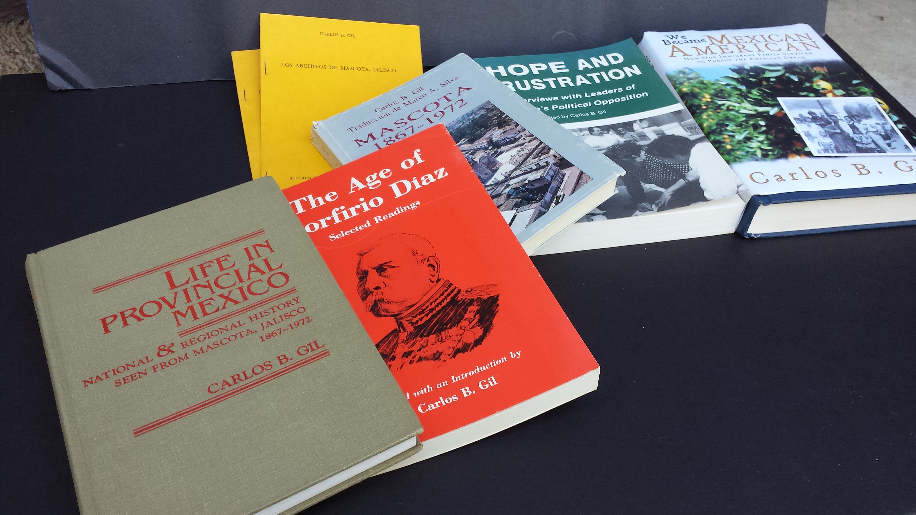

Slide 3
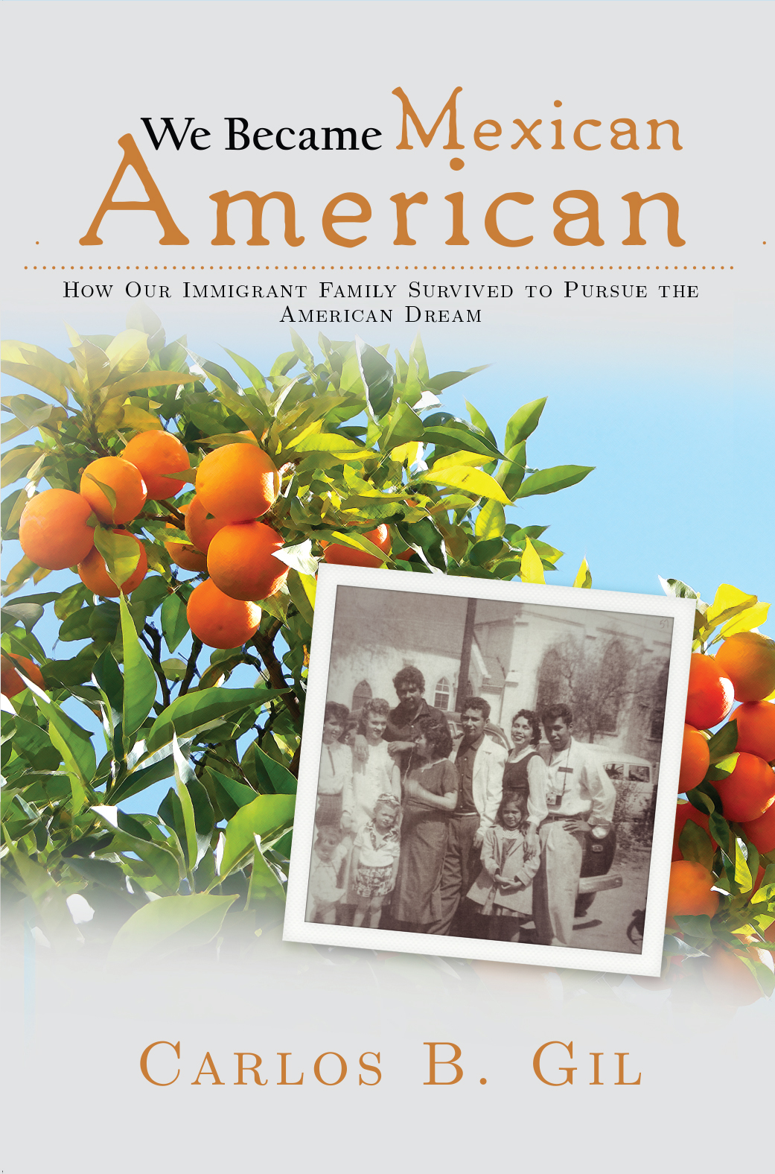

Slide 4
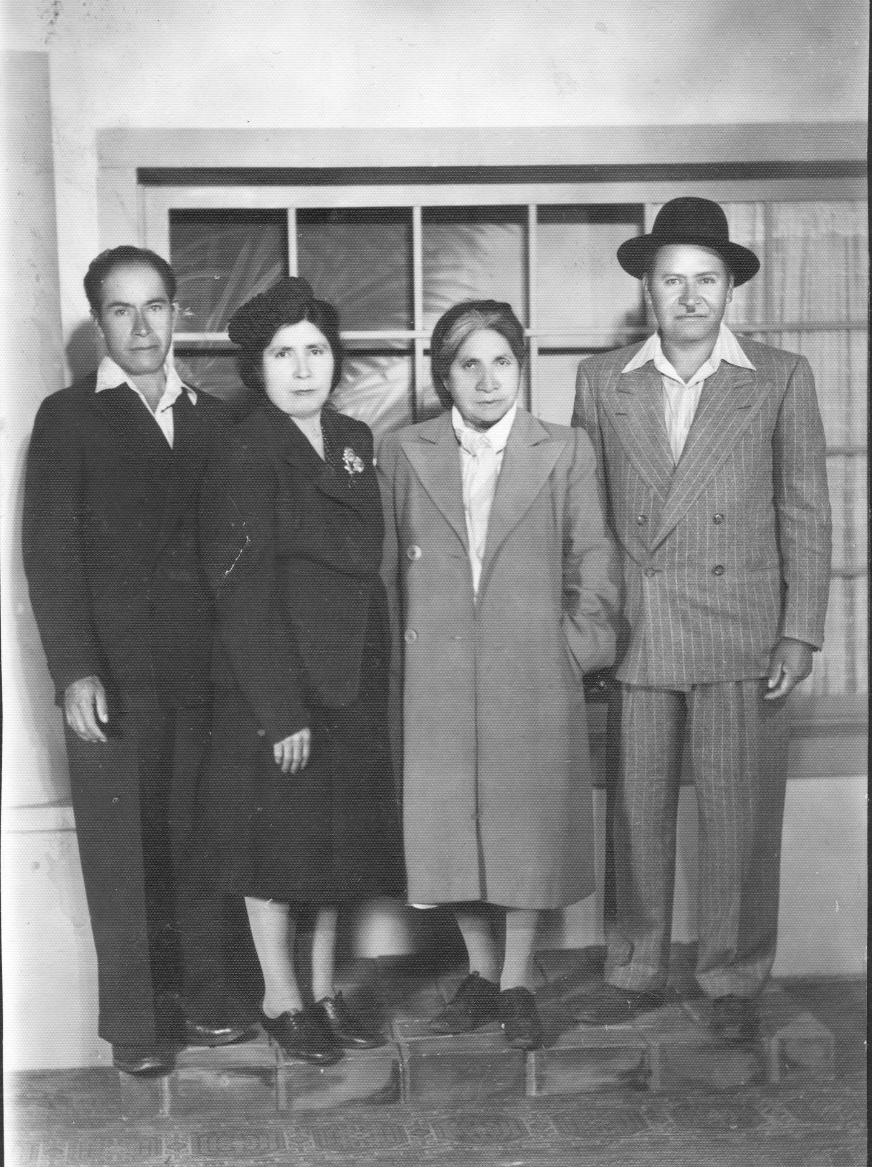
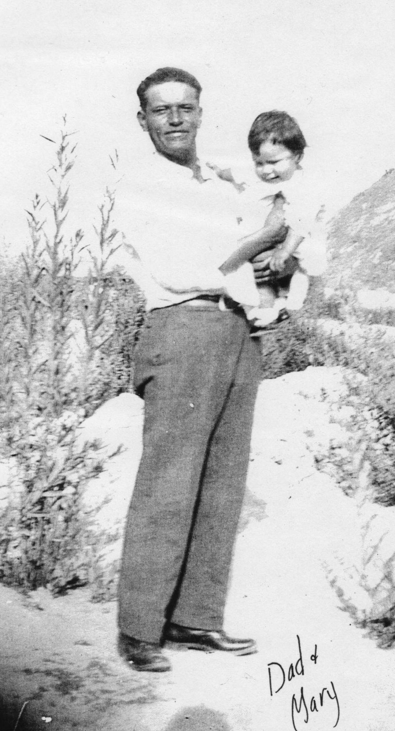

Slide 5
One
While we may find ourselves in the PNW
We are historically rooted in the Southwest.
Your ancestors (parents, grandparents etc.)
Most probably came from the SW (Texas, AZ, CA)

Slide 6
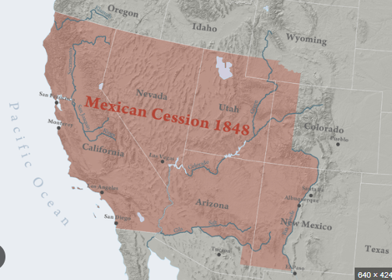
TREATY OF GUADALUPE HIDALGO ENDS MEXICAN AMERICAN WAR 1848

Slide 7
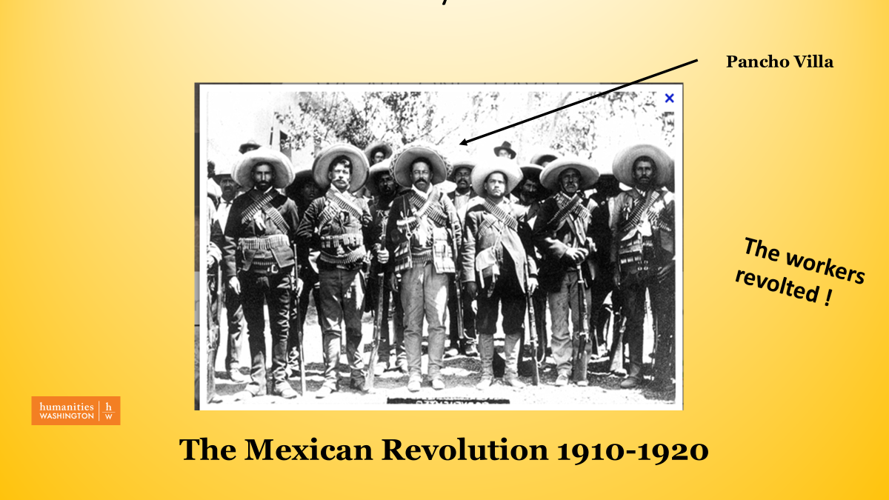

Slide 8
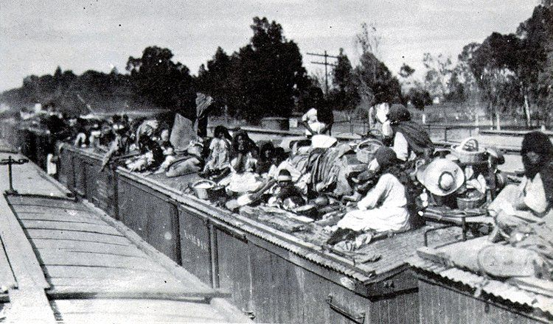

Slide 9
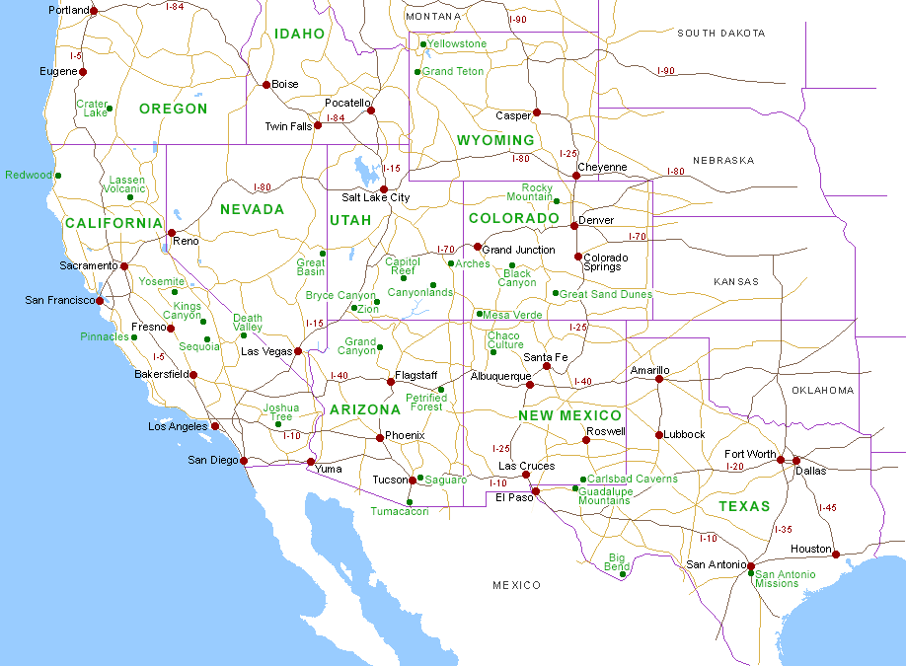
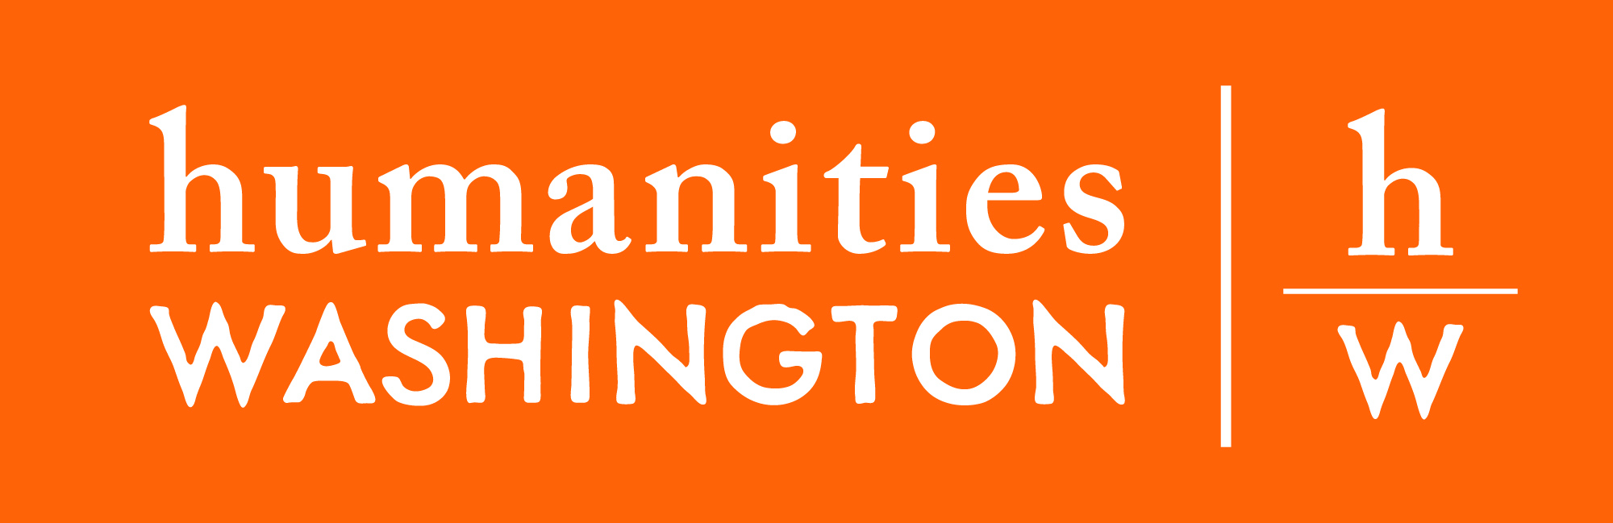
DISTRIBUTION OF MEXICAN IMMIGRANTS TO 1930

Slide 10
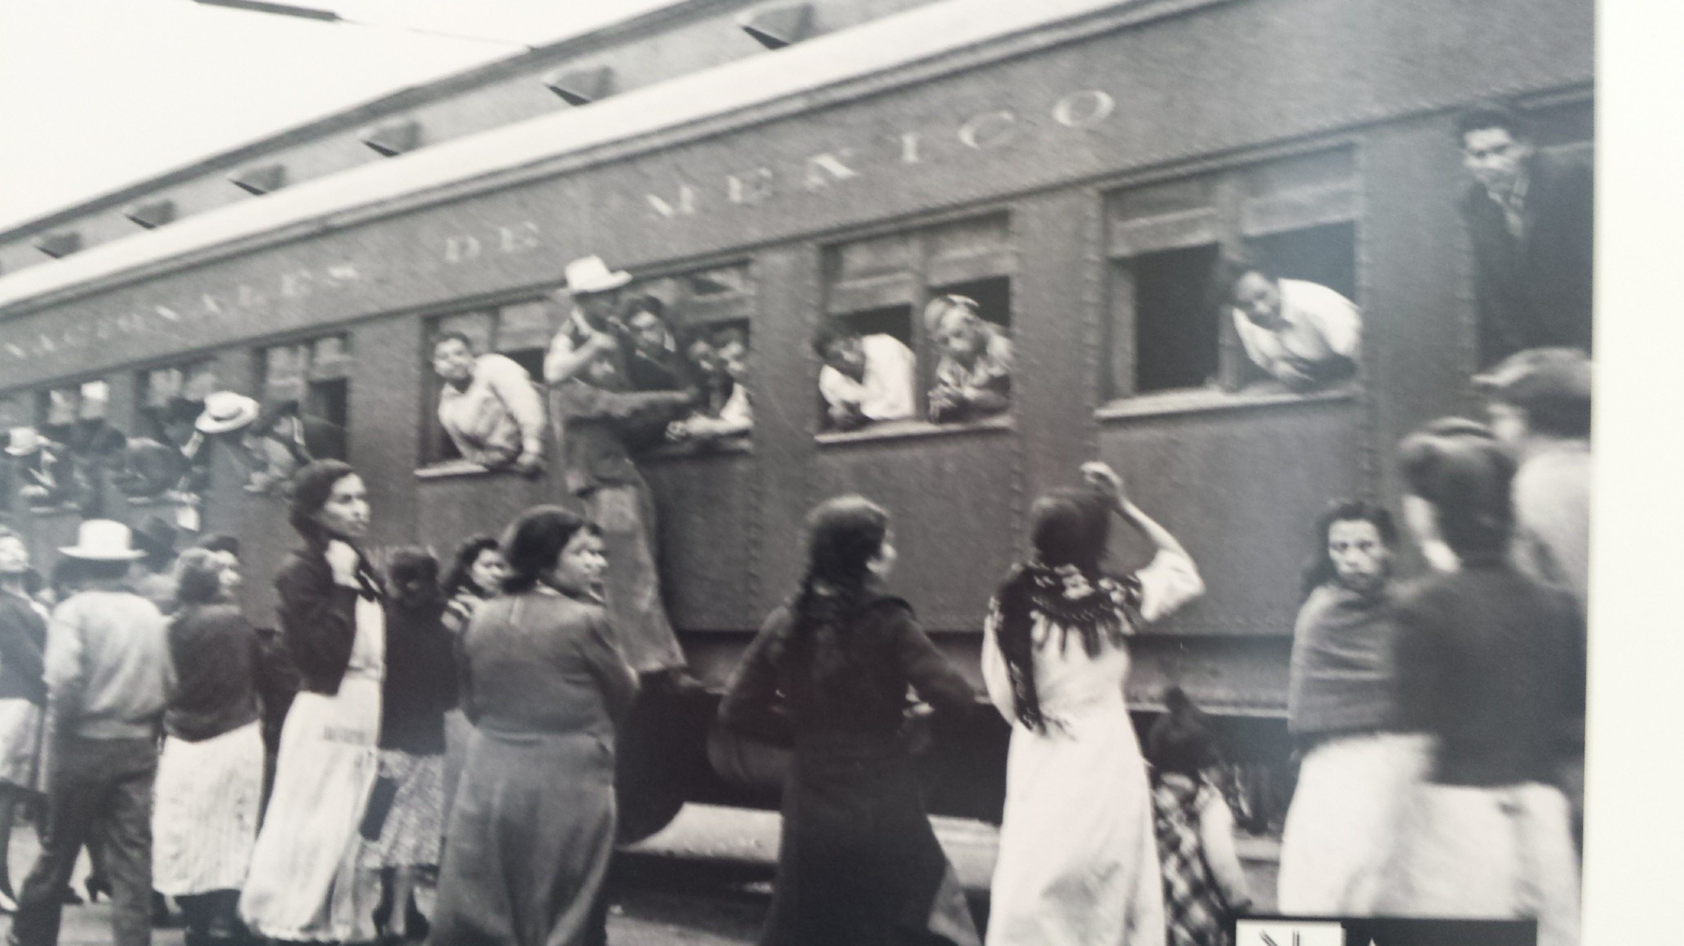
Braceros traveling to the U.S.

Slide 11
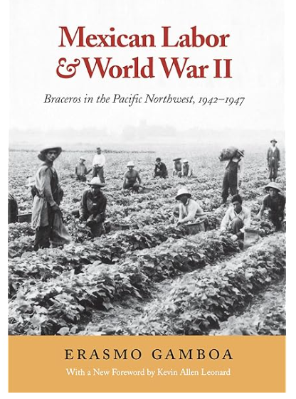

Slide 12
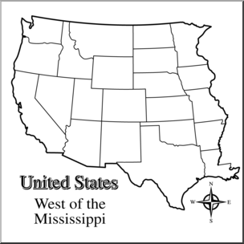

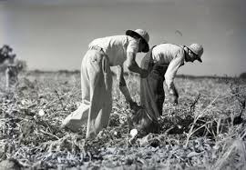
Mexicans arriving in Eastern Washington during and after World War II
sugar beets
el betabel

Slide 13
Two POWER

Slide 14

POWER
It is the ability to influence or control the behavior of
people, events, or even the direction of a society

Slide 15
YOU CAN DEVELOP POWER THROUGH
SKILLS AND EDUCATION

Slide 16
THREE
LOCAL EXAMPLES OF LATINOS
WHO HAVE DEVELOPED POWER

Slide 17
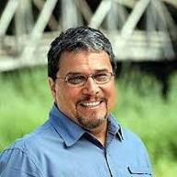
Luis Moscoso
He is one of the first Latino members of the Washington State House of Representatives. Born in Iowa of a Peruvian dad and American mom, he came to WA and became a bus driver and then became a union activist. He is a Peruvian American. Age 75.

Slide 18
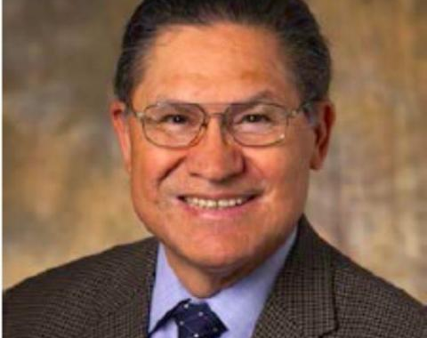
Rogelio Riojas
Rogelio Riojas: Long-time President and CEO of Sea Mar Community Health Centers. Rogelio was born in West Texas and attended high school in Othello. Riojas belonged to the UW chapter of MEChA and Seattle’s Brown Berets. He obtained degree in political science at the UW and a master’s in health administration. Member of the UW Board of Regents 2020-2021.

Slide 19
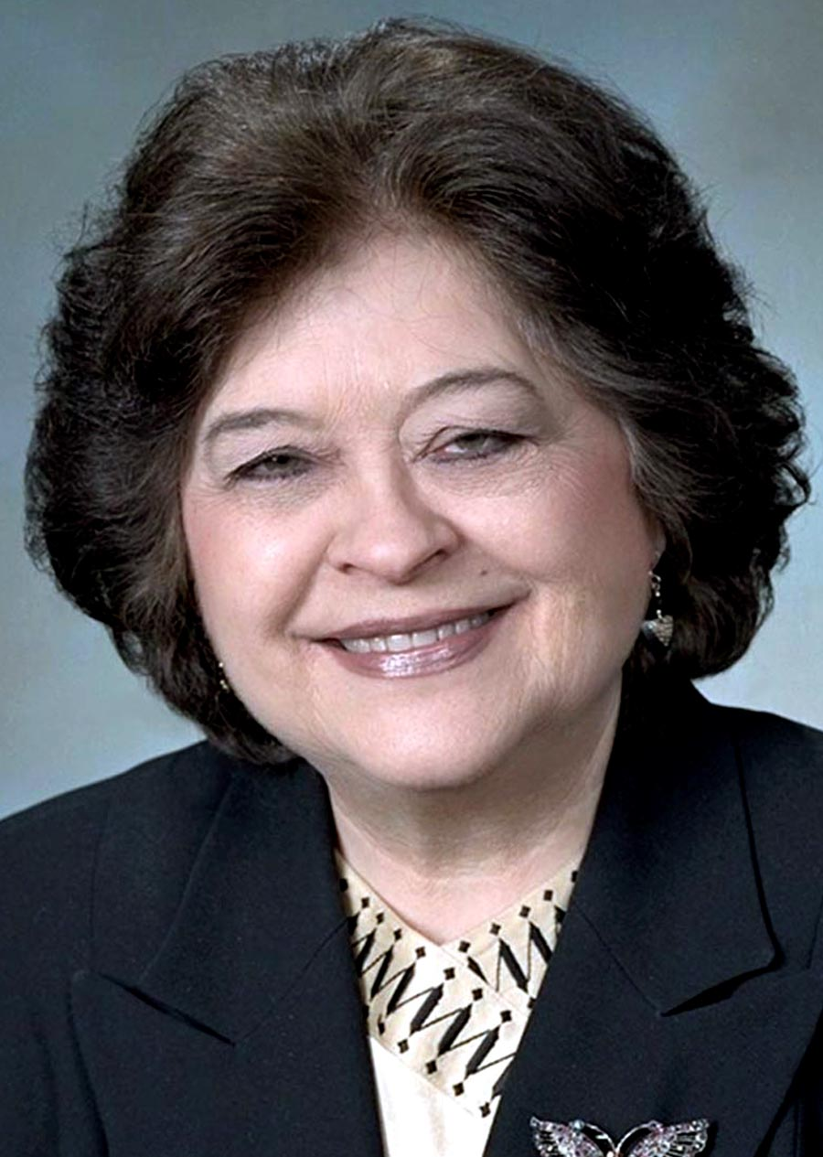
Phyllis Gutierrez Kenney
Phyllis Gutierrez Kenney, d. 2025 at age 89: A pioneering Latina in state politics who served in the Washington State Legislature from 1997 to 2013. Her parents were Mexican farm workers, and she worked in the fields picking potatoes and other crops. She attended Columbia Basin College and became an activist for migrant workers.

Slide 20
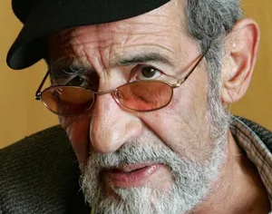
Roberto Maestas
Co-founder of El Centro de la Raza, a bastion of civil rights and social services since 1972. Migrant worker from New Mexico, graduated from the University of Washington and fought for the civil rights of Latinos in WA state. Died 2010 at age 72.

Slide 21
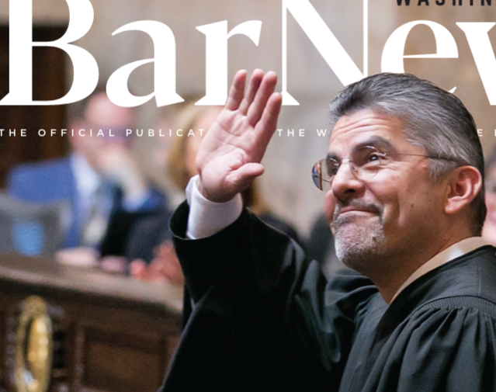
Steven C. Gonzalez
Washington Supreme Court Justice. Age 62, he was born of a Mexican father and a Jewish mother, was the first to graduate from college and earned his law degree from UC Berkeley. He also studied in Japan and speaks Japanese and Spanish.

Slide 22
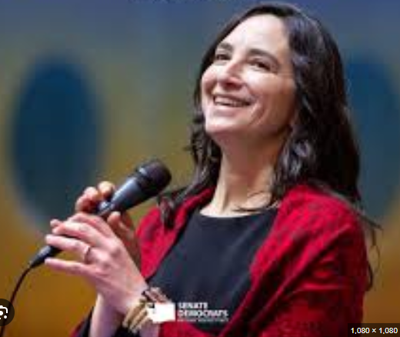
Rebecca Saldaña
She is a Washington State Senator. Born in west Seattle / Dad was farm worker turned machinist / mom comes from a family of German descended farmers from the Midwest. She graduated from Seattle University.

Slide 23
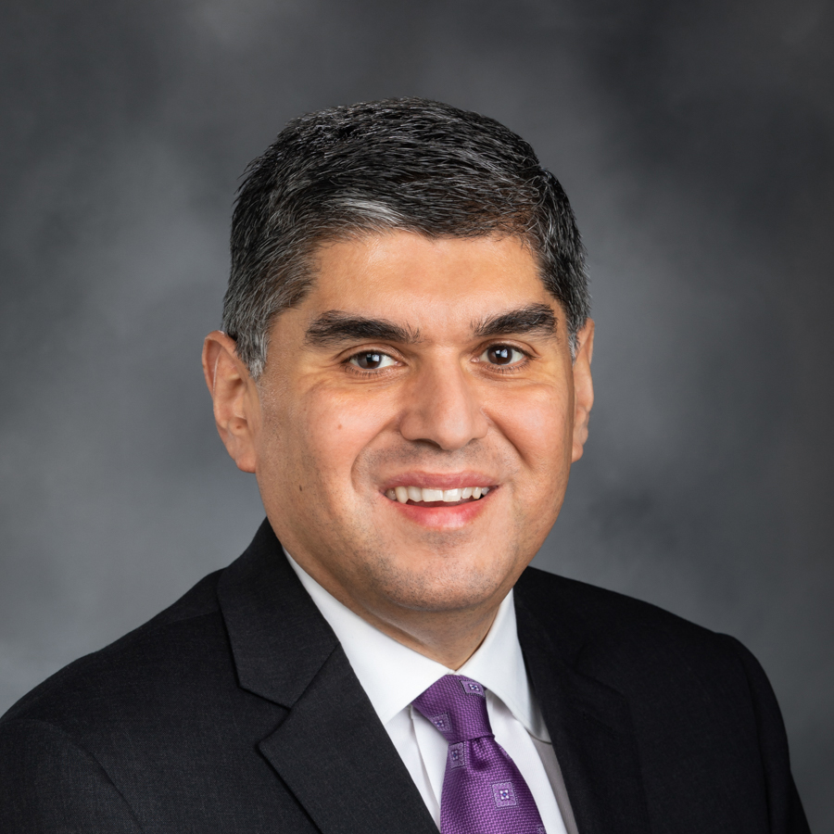
Javier Valdez
Washington State Senator. Born in Moses Lake, he is the son of farm workers. After graduating from high school, he enrolled at the University of Washington graduating with a Bachelor of Arts in business education followed by a Master’s degree in public administration from City University of New York.

Slide 24
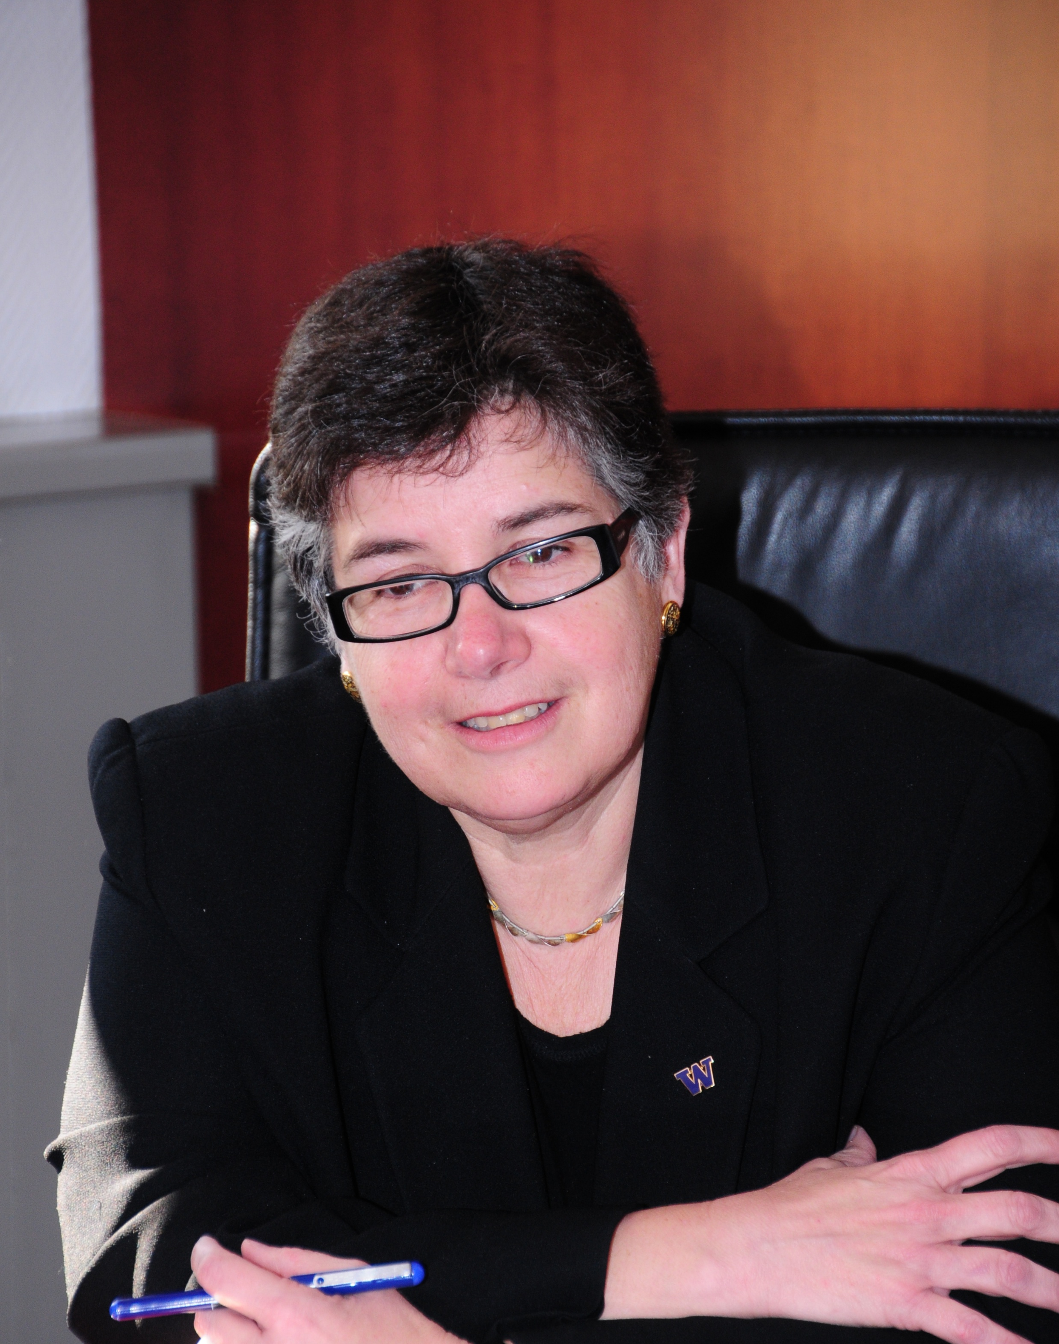
Ana Mari Cauce. President of the University of Washington, 2011-2025. Born in Miami, her family fled Cuba to Miami soon after the Castro revolution. Wanting to become a journalist she attended University of Miami, and when she graduated, she applied to Yale and studied psychology and African American Studies becoming enamored with these new fields. She nearly dropped out when her brother was killed by members of the Klu Klux Klan but she persevered. Obtaining a Ph.D. she was hired by the Department of Psychology of the University of Washington. She also served as adjunct professor in the Ethnic Studies Department.

Slide 25
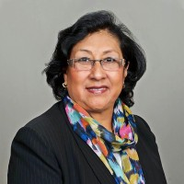
Rosario Reyes
Founder and CEO of the Latino Educational Training Institute (LETI). Born in Peru and influenced by her father, a local teacher, she immigrated to the Unted States to become a businesswoman, founded LETI and became CEO.

